Slide 1
Food Traditions

Slide 2
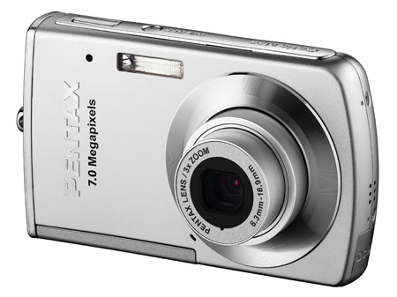
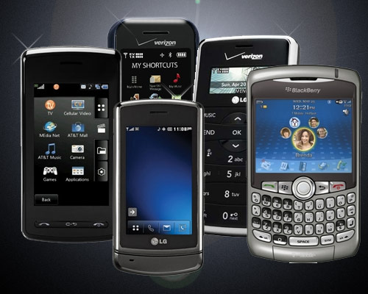
Take 3 - 5 Digital Pictures

Slide 4
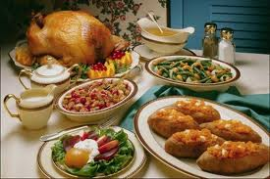
Traditions

Slide 5
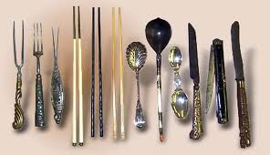
What we eat with

Slide 6
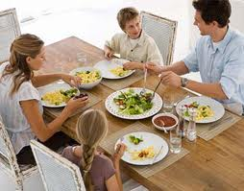
Who we eat with

Slide 7
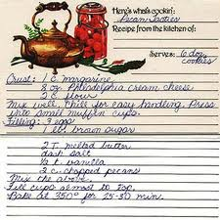
A family recipe

Slide 8
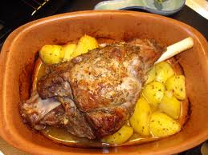
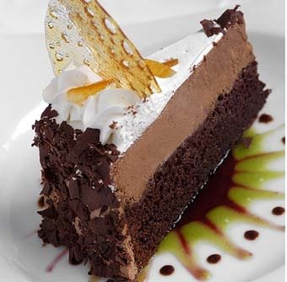
A favorite dish or dessert

Slide 9
Email the pictures
2 – 3 sentences describing each picture
Who is in the picture ?
What is the picture of ?
Why is it special to you ?

Slide 10
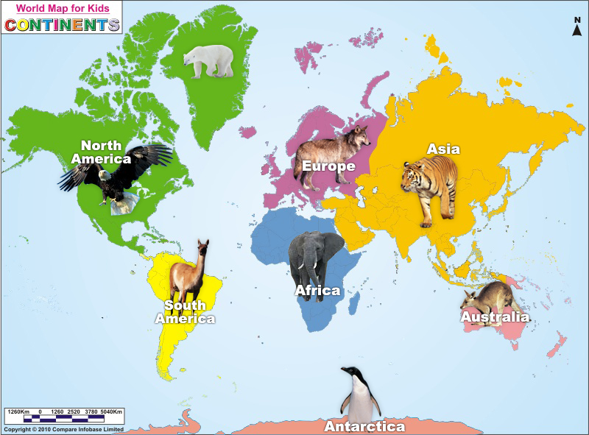
Where is the United States?

Slide 11
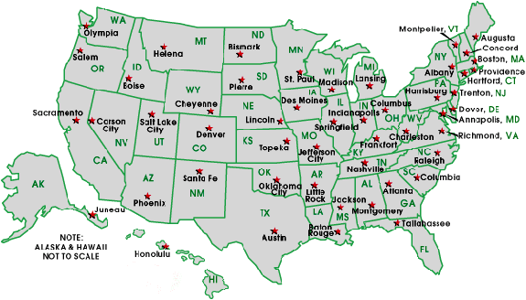
Where is Texas?

Slide 12
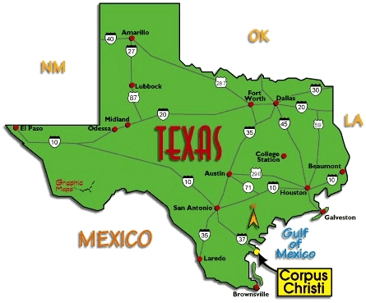
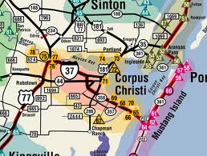
Corpus Christi, Texas

